Slide 1



Ecommerce-Store-Dashboard-PowerBI
View in Power BI
Last data refresh:
4/21/2023 10:46:34 AM UTC
Downloaded at:
4/21/2023 10:49:45 AM UTC

Slide 2
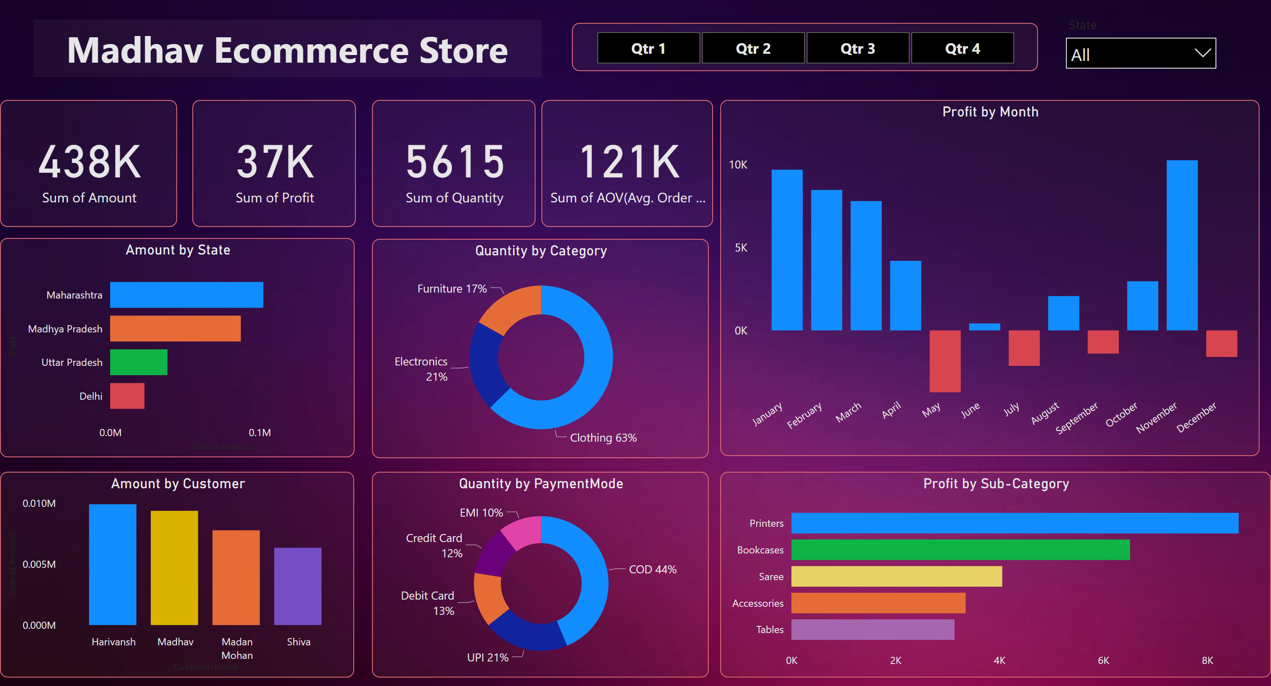
Page 1
Notes:
Amount by Customer
No alt text provided
Amount by State
No alt text provided
Quantity by Category
No alt text provided
Quantity by PaymentMode
No alt text provided
Profit by Month
No alt text provided
Profit by Sub-Category
No alt text provided
card
No alt text provided
card
No alt text provided
card
No alt text provided
card
No alt text provided
slicer
No alt text provided
textbox
No alt text provided
slicer
No alt text provided

